Slide 1
KEYLOGGER TOOL
CAPSTONE PROJECT
Presented By:
Shiyam Ganesh T
B.E. Computer Science and Engineering
College of Engineering, Guindy

Slide 2
OUTLINE
Problem Statement
Proposed System/Solution
System Development Approach
Algorithm & Deployment
Result
Conclusion
Future Scope
References

Slide 3
Problem Statement
In today's digital age, where cybersecurity threats loom large, one of the significant concerns is the proliferation of keyloggers, stealthy software tools designed to monitor and record keystrokes on a user's computer without their knowledge. Keyloggers pose a severe threat to individuals and organizations as they can capture sensitive information such as passwords, credit card details, and other personal data, leading to identity theft, financial loss, and privacy breaches.

Slide 4
Proposed Solution
The proposed solution for the Python Keylogger project aims to provide a robust and efficient tool for capturing keystrokes on a target system. Keyloggers serve various purposes, from monitoring user activity for security purposes to parental control or even as a part of penetration testing tools. Our solution emphasizes reliability, stealthiness, and extensibility to meet diverse requirements.
The proposed solution for the Python Keylogger project offers a comprehensive framework for capturing and managing keystroke data with a focus on reliability, security, and privacy.

Slide 5
System Approach
System Requirements:
Before delving into the development and implementation of the Python keylogger tool, it's essential to outline the system requirements to ensure compatibility and smooth operation across various environments. The key requirements include:
Operating System: The keylogger should be compatible with major operating systems such as Windows, macOS, and Linux.
Python Version: Python 3.10+ is required for effective development and execution of the keylogger.
Libraries Required to Build the Model:
pynput: This library provides cross-platform support for monitoring and controlling input devices such as keyboards and mice.
os: The os module provides a portable way of interacting with the operating system, facilitating tasks such as file management, process handling, and system information retrieval.

Slide 6
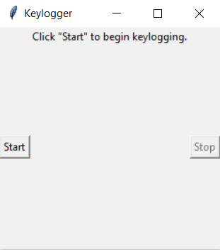
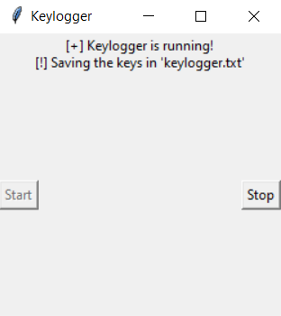
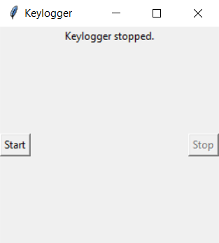
IMPLEMENTATION:
Keylogger prompts user to start
The tool
Keylogger is running, records the keyboard activity of the user
Keylogger is stopped, results are stored in key_log.txt

Slide 7
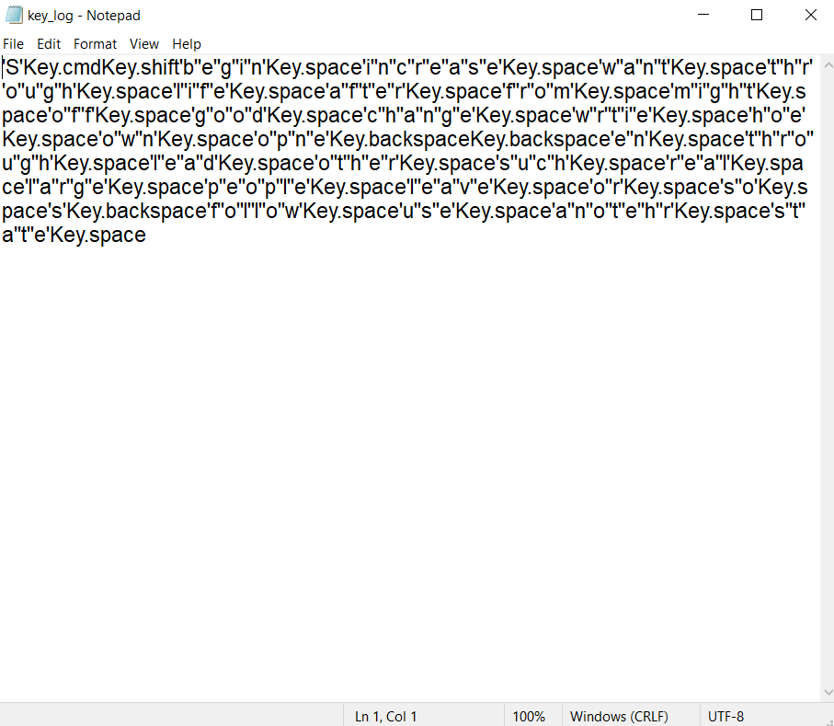
Result:
Results of keyboard activity captured by the keylogger:

Slide 8
Conclusion
In conclusion, the development and implementation of the Python keylogger project offer a comprehensive solution for monitoring and capturing keystrokes on target systems. Throughout the project, we've emphasized reliability, security, and user configurability to meet diverse requirements while adhering to ethical considerations and legal compliance.
Through the integration of libraries such as pynput, os, and json, we've created a robust framework for capturing keystrokes and storing data.
As technology continues to evolve, it's crucial to remain vigilant regarding security and privacy concerns. Therefore, we should emphasize the importance of using this keylogger tool responsibly and ethically, respecting the privacy rights of individuals and adhering to applicable laws and regulations.

Slide 9
FUTURE SCOPE
Cross-Platform Compatibility: Extending the keylogger's compatibility to emerging platforms and environments, such as mobile devices (iOS, Android) and cloud-based systems. This entails adapting the keylogger's functionality to diverse operating systems and input device architectures.
Integration with Security Suites: Collaborating with cybersecurity vendors to integrate the keylogger functionality into comprehensive security suites or penetration testing frameworks. This facilitates holistic security assessments and incident response by providing insights into user interactions and potential vulnerabilities.

Slide 10
THANK YOU

